Slide 1

Exam Prep: Microsoft Technology Associate 98-365: Windows Server Administration Fundamentals

Slide 2
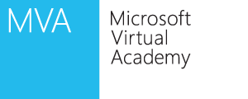
Course Topics
Windows Server Administration Fundamentals
01 | Server Overview
02 | Managing Windows Server 2022
03 | Managing Storage
04 | Monitoring and Troubleshooting Servers
05 | Essential Services
06 | File and Print Services
07 | Popular Network Services and Applications
Notes:
1 minute

Slide 3
Server Overview
Module 1

Slide 4
Objectives
Skills/Concepts | Objective Domain Description | Objective Domain Number
Installing Windows Server 2022 | Understand server installation options. | 1.3
Introducing Server Roles | Identify application servers. | 2.1
Comparing Physical Servers and Virtual Servers | Understand server virtualization. | 2.5
Selecting Server Hardware | Identify major server hardware components | 5.1
Identify Methods to Install Windows Servers | Understand updates. | 6.3
Notes:
This should also be a review for the 70-642.

Slide 5
Server
A server is a computer that provides services, and a client is a computer that requests services.
A network made up of servers and clients is known as a client/server network
A server-based network is the best network for sharing resources and data, while providing centralized network security for those resources and data
Networks using Windows Server are typically client/server networks
Notes:
A computer is providing services and requesting services.
While computers with Windows Server 2003 and Windows Server 2008 are designed to provide services, they can also request services from other computers.

Slide 6
Server Roles
Windows Servers use ‘roles’ to define what services the server provides
A server can have multiple roles installed
When you are determining hardware and software needs, look at the role the computer needs to fill and the load the computer will be placed under
File Services
Web Services
Directory Services
Notes:
Some of the more common server roles include:
File services
Print services
Web services
Remote access
Application servers
Email server
Database server

Slide 7
Selecting Server Hardware
When choosing server hardware keep the following in mind:
Performance - Servers are intended to provide network services to many users
Availability - If the server fails or becomes unavailable, the issue will affect multiple people
Cost – How to balance available budget with the goals of performance and availability
Performance
Availability
Cost

Slide 8
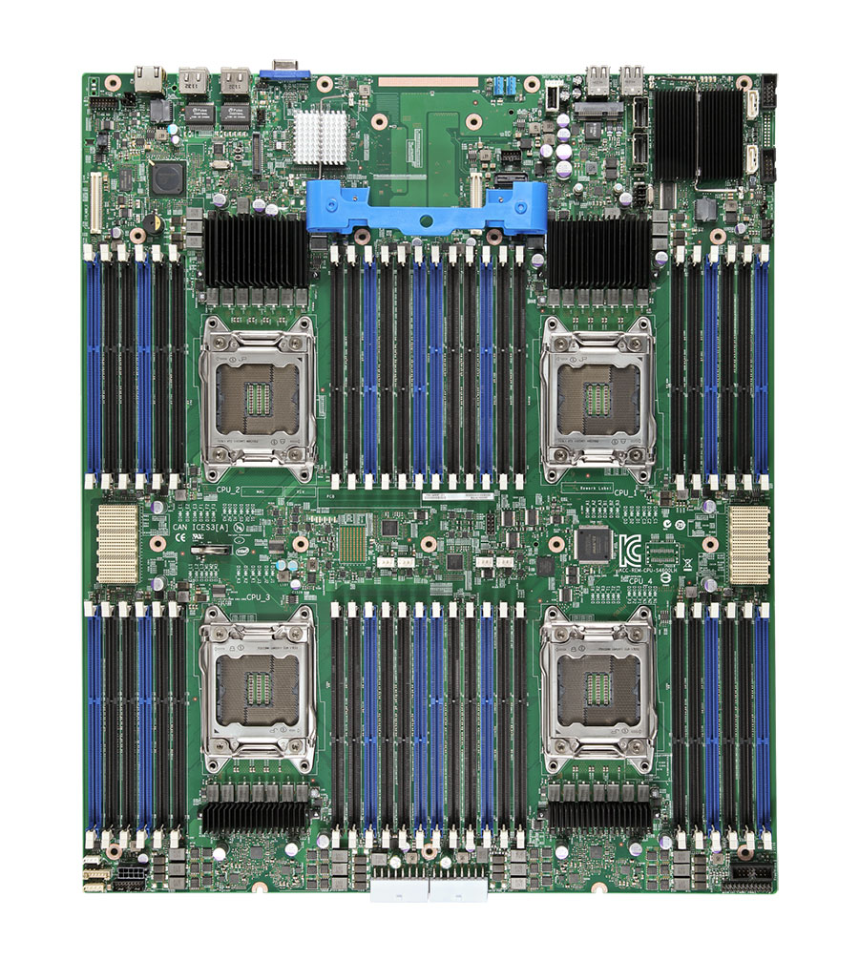
Primary Subsystems
Processor
Memory
Storage
Network
Failure in any of these subsystems can cause the entire system to fail
They can also cause a bottleneck that can affect performance of the entire system

Slide 9
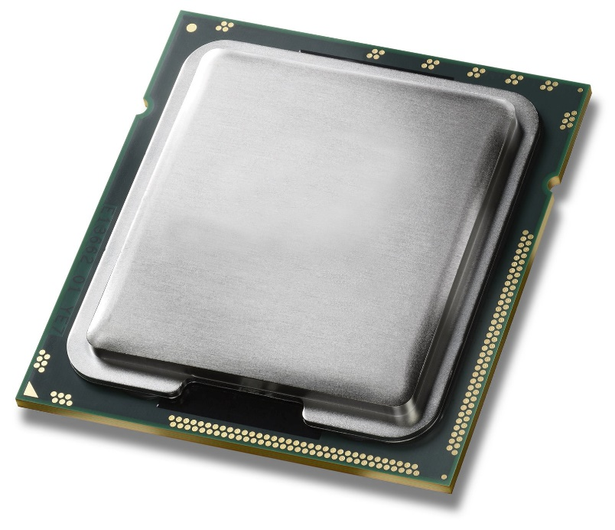
Processor
Processors are typically 64-bit, which can process faster than 32-bit processors
32-bit processor – 4 Gigabytes of RAM
64-bit processor – 1 Terabyte of RAM
A processor can only work on a single process / thread at a time
Time slicing enables multiple threads and applications to be running at the same time
A multicore processor enables multiple threads / application instructions to be worked on at the same time
Notes:
The clock speed of a processor is usually expressed in gigahertz (GHz).
Most of the processors sold today are multi-core processors, which are like having two or more processing cores packaged as one.
Today, the newer processors are 64-bit, which work faster than the older 32-bit processors.
With more data in memory, a 64-bit processor can work faster because it can access larger amounts of RAM instead of swapping data back and forth with the much slower disks

Slide 10
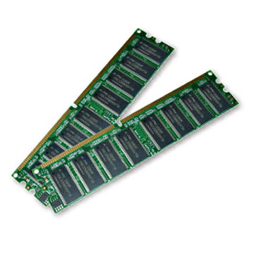
Memory
Random Access Memory (RAM) is the computer’s short-term or temporary memory
It stores instructions and data that the processor accesses directly
If you have more RAM, you can load more instructions and data from the disks
Having sufficient RAM can be one of the main factors in your computer’s overall performance
Notes:
Unfortunately, when power is cut to the RAM, like when you shut off your PC, the contents of the RAM disappear. This is the reason you use disks rather than RAM for long-term storage.

Slide 11
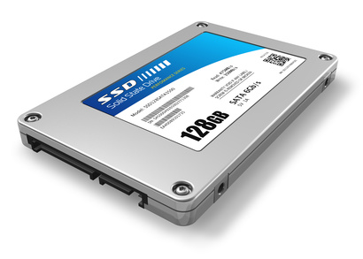
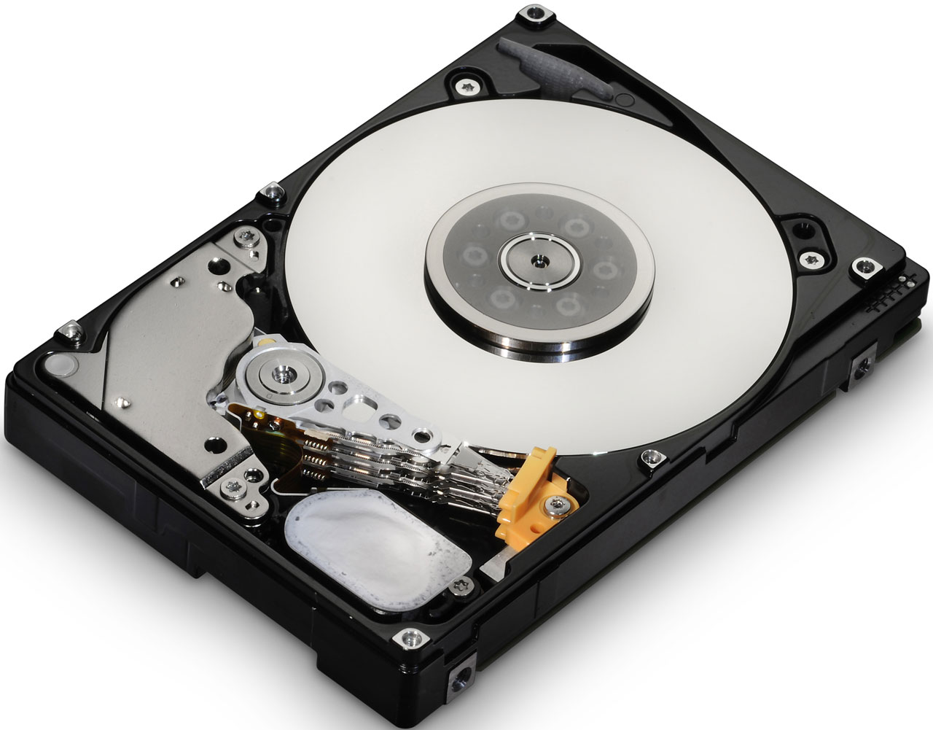
Storage
Traditionally, hard drives are half electronic/half mechanical devices that store magnetic fields on rotating platters
Solid-state drives are electronic devices with no mechanical components
Personal computers typically only have local storage consisting of internal hard drives
Servers may also connect to external storage through a network-attached storage (NAS) or storage area network (SAN)

Slide 12
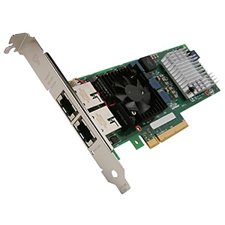
Network
A network connection enables a device to communicate with servers or the clients
Most devices include one or more network interface cards or NICs
Speeds of today’s network cards are 100 Mbit/second, while a typical speed for servers is 1 Gbit/second or faster

Slide 13
Motherboard
Motherboard is the main printed circuit board that brings these four subsystems together
The processor plugs in or connects to the motherboard or system board enabling communication with the rest of the system
The motherboard provides the electrical connections enabling components of the system to communicate
Notes:
Although everything is made around the processor, the motherboard is considered the nervous system of the PC. Motherboard capabilities have been greatly expanded (most include sound and network connectivity), and you can further expand the capabilities of the system by installing expansion cards (sometimes referred to as daughter boards).

Slide 14
BIOS
Basic Input/Output System (BIOS) are the instructions that control most of the computer’s input/output functions
BIOS functions include communicating with disks, RAM, and the monitor kept in the System Read Only Memory (ROM) chips
By having instructions (software) written on the BIOS, the system already knows how to communicate with some basic components such as a keyboard and how to read some basic disks such as IDE drives
The BIOS also looks for additional ROM chips that may be on the motherboard or on expansion cards that you add to the system
Flashing the BIOS is the process of updating your system ROM BIOS
Notes:
If you have not realized it by now, instructions written on the BIOS is software.
Unfortunately like any software, the BIOS may need to have a bug fixed or may need to be expanded to support a new type of hardware that did not exist when the BIOS was written.
Sometimes a newer BIOS version can lead to better system performance.
To overcome some problems, you should check with your system or motherboard manufacturer to see if they have a new version of the BIOS.
The process of updating your system ROM BIOS, is called flashing the BIOS.
Unfortunately, flashing the BIOS is a delicate process. If the process gets interrupted in the middle or you install the wrong version, your system may not become accessible and you may have to replace your motherboard to overcome the problem.

Slide 15
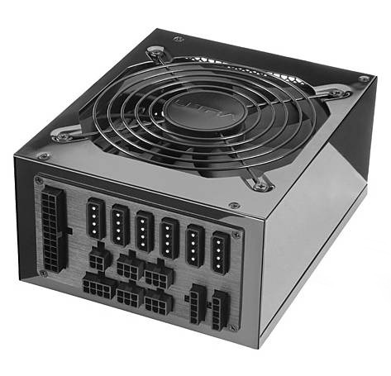
Power Supply and Cases
A case provides an enclosure that helps protect system components that are inside
A case with the power supplies and additional fans are usually designed to provide a fair amount of airflow through the system to keep the system cool
The power supply supplies electrical power to the mother board and components

Slide 16
Ports
Ports are plug sockets that enable you to connect peripheral deices to your computer
Devices can include a printer, keyboard, mouse, external drive or another computer
Types of ports:
Ethernet
Parallel
PS/2
Serial
VGA
USB
SCSI
HDMI
Audio

Slide 17
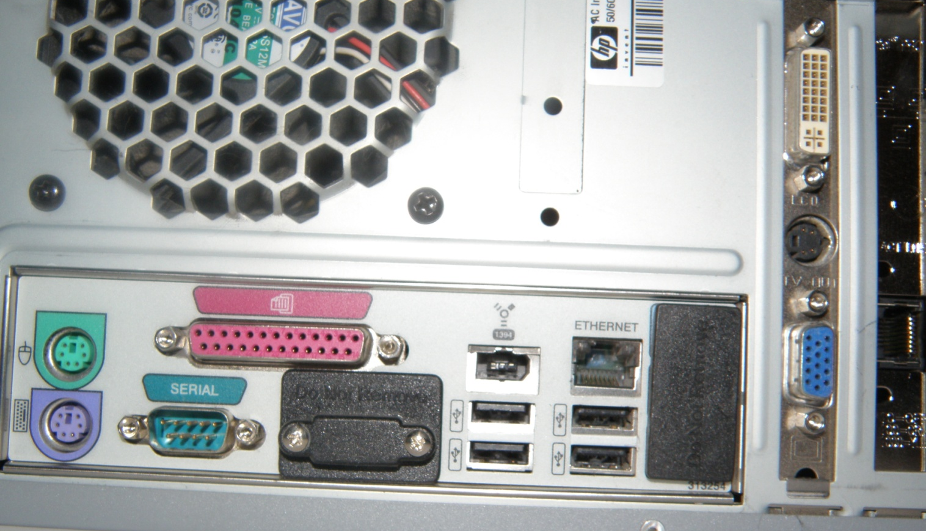
Ports

Slide 18
Virtual Servers
Virtual machines or virtual server technology enables multiple operating systems to run concurrently on a single machine
Virtual servers allows for a separation of services so that changes on one virtual server do not affect the other virtual servers
Virtualization offers a better way utilize hardware since most hardware is sitting idle most of the time

Slide 19
Locating the Server
After you select and purchase the server and its components, you also need to determine where to physically locate the server
The server room is the work area of the Information Technology (IT) department that contains servers and most of the communication devices including switches and routers
The room should be secure, with only a handful of people allowed to have access to it

Slide 20
Software
Software contains the instructions that the hardware follows, which make the computer do what it does.
It provides us with an interface that we can use to configure and manage the computer
Configuring a server:
Select, install and configure the operating system
Select, install and configure the services that the operating system provides
Install and configure additional software on the server

Slide 21
Windows Servers
Windows NT (first released in 1993) is a family of operating systems produced by Microsoft
Since then, Microsoft has built on the previous version and released:
Windows 2000 Server
Windows Server 2003
Windows Server 2003 R2
Windows Server 2008
Windows Server 2008 R2
Windows Server 2012
Windows Server 2012 R2
Windows server 2016
Windows Server 2019
Windows Server 2022

Slide 22
Windows Server 2008 R2
Windows Server 2008 R2 editions
Windows Server 2008 R2 Foundation
Windows Server 2008 R2 Standard
Windows Server 2008 R2 Enterprise
Windows Server 2008 R2 Datacenter
Windows Web Server 2008 R2
Windows Server 2008 R2 for Itanium-Based Systems
Windows Server 2008 R2 is only available in 64-bit version

Slide 23
Windows Server Roles
A server provides services
Windows Server 2008 R2 has organized the most common services into server roles
A server role describes the function of the server
Windows Server 2008 R2 server features are software programs that are not directly part of a role
Server features augment the functionality of one or more roles to enhance the functionality of the server

Slide 24
Full Installation and Server Core
Starting with Windows Server 2008, you can install Windows in one of two modes (both of which are provided on the installation DVD) :
Full Version
Server Core
The full installation has a fully functional GUI interface and supports installing all available server roles and other Microsoft third-party software
Server Core installation provides a minimal environment with no Windows Explorer shell that only supports certain server roles
Desktop experience
Notes:
The full version is the normal version that you would expect from Windows with a fully functional GUI interface.

Slide 25
Windows Server 2022 R2 System Requirements
Component | Requirement
Processor | Minimum: 1.4 GHz (x64 processor)
Memory | Minimum: 512 MB RAM
Disk Space Requirements | Minimum: 32 GB
Display | Super VGA (800 x 600) or higher resolution monitor
Other | DVD drive, keyboard and Microsoft mouse (or compatible pointing device), and Internet access

Slide 26
Clean Installation
A clean installation installs the operating system to a new directory
Select a clean installation in the following cases:
No operating system is installed on the computer
The installed operating system does not support the installation or upgrade
To configure a multi-boot configuration
A clean installation is preferred
Performing a clean install of an operating system can be the preferred method because all files are installed again
The disadvantage is that the system and all of its software needs to be reinstalled, patched, and configured and data copied over, something that may take hours or even days

Slide 27
Sysprep
If a Windows installation is cloned, each target computer using the same image will have the same parameters, including the same computer name and security identifier (SID)
For these computers to operate properly without conflict on a network, these parameters have to be unique
To overcome these conflicts, you run the system preparation tool (Sysprep)
Benefits of Sysprep
Removes system-specific data from Windows
Configures Windows to boot to Audit mode
Configures Windows to boot to Windows Welcome
Resets Windows Product Activation

Slide 28
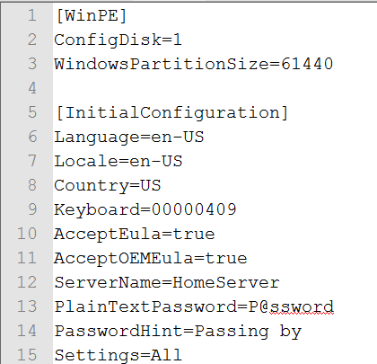
Unattended Installation
An unattended installation enables you to automate the configuration and deployment of operating systems
An answer file is used to perform an unattended installation of Windows
An answer file is an XML file that stores the answers for a series of graphical user interface (GUI) dialog boxes
You can use any text editor such as notepad to create and modify the answer file, Server Image Manager can also be used

Slide 29
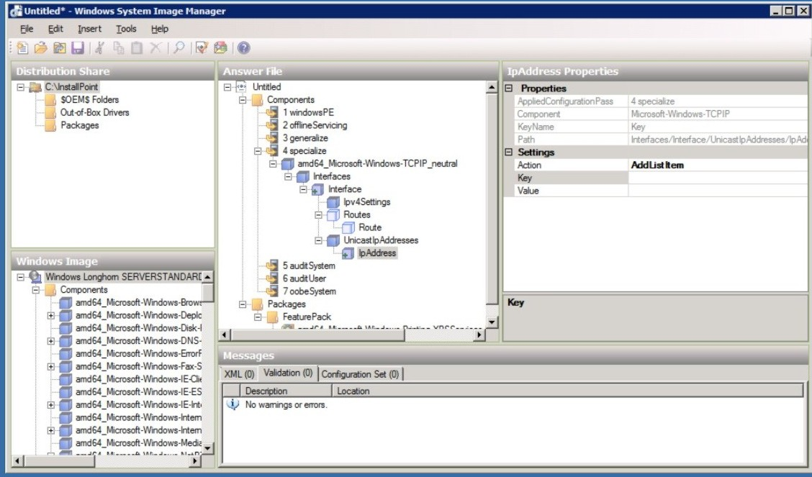
Server Image Manager

Slide 30
Windows Deployment Services
Windows Deployment Services (WDS) is a technology from Microsoft for network-based installation of Windows operating
Windows Deployment Services is the updated and redesigned version of Remote Installation Services (RIS)
The deployment of Windows can be fully automated and customized through the use of unattended installation scripting files
Benefits
Allows network-based installation of Windows operating systems
Deploys Windows images to computers without operating systems
Uses standard Windows Setup technologies including Windows PE, .wim files and image-based setup
Create images using a reference computer using the Image Capture Wizard

Slide 31
Windows Imaging Format (WIM) File
Windows installation files can be distributed within a Windows Imaging Format (WIM) file
WIM is the file-based imaging format that Windows Server uses for rapid installation on new computers
WIM files store copies (known as images) of the operating systems
Notes:
Windows Deployment Services uses the WIM files to install Windows.
If set up properly, you need to boot a computer with Windows PE 2.0 or 3.0 or perform a PXE boot. Windows Preinstallation Environment (Windows PE) 2.0 is a minimal Win32 operating system with limited services, built on the Windows kernel.
It is used to prepare a computer for Windows installation, to copy disk images from a network file server, and to initiate Windows Setup.

Slide 32
Windows Licensing
A software license is purchased from a software company like Microsoft that gives you permission to use a specific software package
Most licenses from corporations such as Microsoft work more like a lease rather than a purchase of the actual software
Licenses are typically purchased for a specific number of users

Slide 33
Windows Activation
Microsoft product activation, including Windows activation, is an anti-piracy technology designed to verify that software products are legitimately licensed
Product activation is included in some technologies
A product key is required to activate the product

Slide 34
Windows Updates
Windows update helps keep your computer safer and your software current by fetching the latest security and feature updates from Microsoft
After installing Windows, run Windows Update to install and apply fixes, patches, service packs, and device drivers
Automatic updating can be enabled to download and install important updates as they become available

Slide 35
DEMO: Windows Update

Slide 36

© 2012 Microsoft Corporation. All rights reserved. Microsoft, Windows, Windows Vista and other product names are or may be registered trademarks and/or trademarks in the U.S. and/or other countries.
The information herein is for informational purposes only and represents the current view of Microsoft Corporation as of the date of this presentation. Because Microsoft must respond to changing market conditions, it should not be interpreted to be a commitment on the part of Microsoft, and Microsoft cannot guarantee the accuracy of any information provided after the date of this presentation. MICROSOFT MAKES NO WARRANTIES, EXPRESS, IMPLIED OR STATUTORY, AS TO THE INFORMATION IN THIS PRESENTATION.

